Slide 1

College of Telecom & Information
Attendance System
Student Names:
Supervisor:
Eng. Ahmad Altalhi
Term 1 - 1443H
16/05/2022

Slide 2
Outline
1 - Introduction
2 – Technologies
3 - Background and motivation of the project
4 - Objectives of the project
5 - Expected results of the project
6-ERD
7- New Features
8- References
9- Demo

Slide 3
Introduction
Task management app for companies. Where managers can assign tasks and send notifications to their employees. And employees can submit given tasks and comment on them.
Some of the features in the app are:
• Three roles and access management.
• Creating departments
• Creating employees.
• Sending notifications.
• Profile settings.
• Track completed and incompleted tasks.

Slide 4





Technologies

Slide 5



Background and motivation of the project
Many managers fail to monitor and assign tasks to employees. Even the employees can get frustrated tracking their tasks and deadlines.
Therefore, our app can organize these tasks between managers and employees and track their progress effortlessly.

Slide 6
Objectives of the project
Admin creates departments and employees accounts
Managers and employees can login to the system with received credentials
Employees can track and submit tasks
Manager can create and assign tasks to employees
Managers and employees receive and send notifications

Slide 7
Expected results of the project
Admin creates departments and employees accounts
Managers and employees can login to the system with received credentials
Manager can create and assign tasks to employees
Employees can track and submit tasks
Managers and employees receive and send notifications

Slide 8
ERD

Slide 9
Upcoming Features
Add comment/chat sections for ease of communication between employee and manager.
Ability to add notification templates or edit them.
Send remainders to the employees that are close to the deadline.
Add option to add profile images.
Filter tasks based on employee, progress, or dates.
Add settings option and forgot password option.
Enhance the app to have adaptable screens size for all phones.

Slide 10
References
• sqflite | Flutter Package (pub.dev)
• Task - Flutter Awesome
• Entity Relationship Diagram (ERD) - What is an ER Diagram? (smartdraw.com)
• Learn Flutter & Dart to Build iOS & Android Apps [2020] | Udemy
• Flutter Code Example (codegrepper.com)
• GitHub - NearHuscarl/flutter_login: Provides login screen with login/signup functionalities to help speed up development

Slide 11
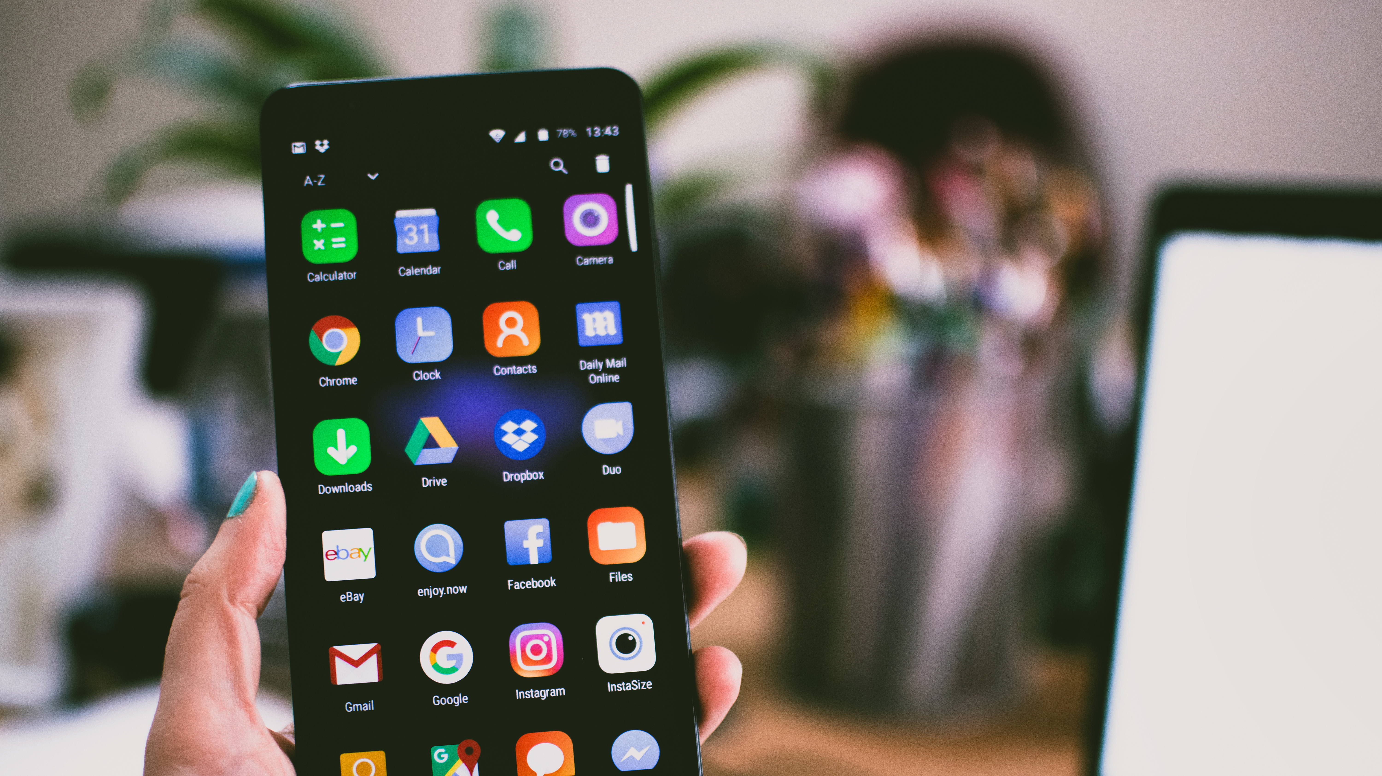
Live demo

